Slide 1
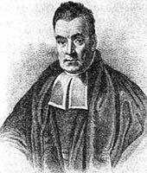
Chapter 2 (Part 1): Bayesian Decision Theory (Sections 2.1-2.2)
Introduction
Bayesian Decision Theory–Continuous Features
Pattern Classification Chapter2(part 1)
0

Slide 2
Introduction
The sea bass/salmon example
State of nature, prior
State of nature is a random variable
The catch of salmon and sea bass is equiprobable
P(ω₁) = P(ω₂) (uniform priors)
P(ω₁) + P( ω₂) = 1 (exclusivity and exhaustivity)
Pattern Classification Chapter2(part 1)
1

Slide 3
Decision rule with only the prior information
Decide ω₁ if P(ω₁) > P(ω₂)
otherwise decide ω₂
Pattern Classification Chapter2(part 1)
2

Slide 4
Use More Information: the class –conditional information
p(x | ω₁) and p(x | ω₂) describe the difference in lightness between populations of sea and salmon

Slide 5
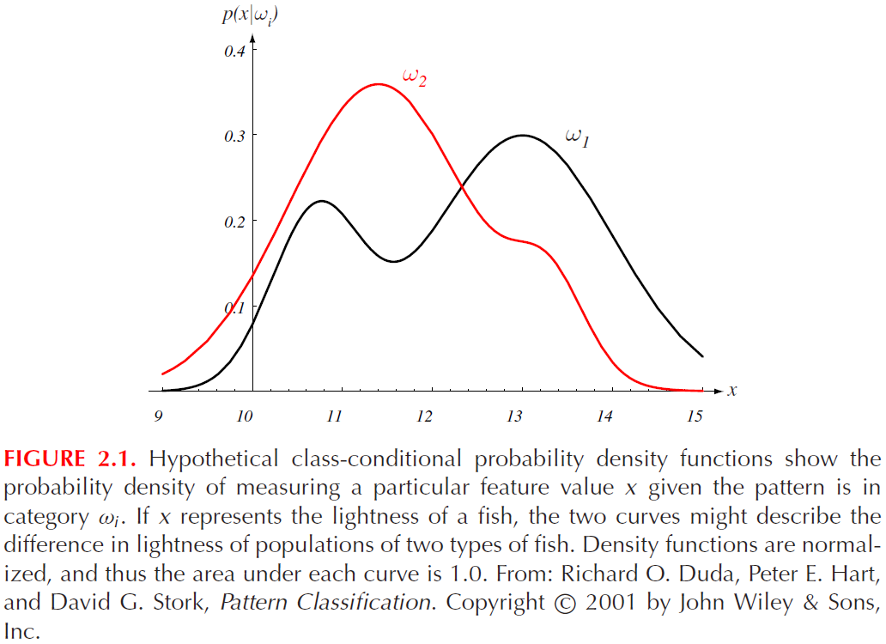
Pattern Classification Chapter2(part 1)
4

Slide 6
Posterior, likelihood, evidence
P(ω_{j} | x) = p(x | ω_{j}) . P(ω_{j}) / p(x)
Where in case of two categories
Posterior = (Likelihood. Prior) / Evidence
Evidence can be viewed as a scale factor
Pattern Classification Chapter2(part 1)
5

Slide 7
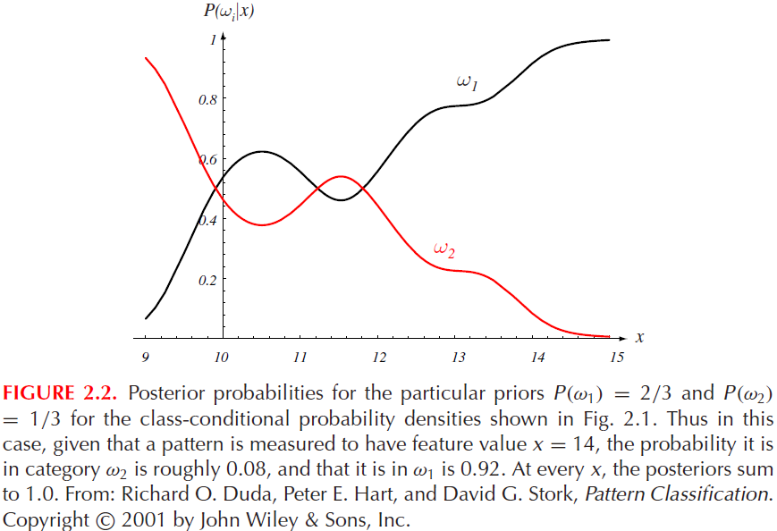
Pattern Classification Chapter2(part 1)
6

Slide 8
There are 1300 students including 1000 males and 300 females. Their heights have been measured. 200 males have heights of 175 cm and 15 females have the same heights.
ω₁ : males ω₂ : females
x= 175 cm (height)
p(x | ω₁)=200/1000 p(x | ω₂)=15/300
p(x)=(200+15)/1300 =
p(ω₁)=1000/1300, p(ω₂)=1000/1300

Slide 9
Two classes
p(ω₁)+p(ω₂)=1
p(ω₁ | x)+p(ω₂| x)=1

Slide 10
Two classes and each sample
has only two status
p(+ |ω₁)+ p(-|ω₁)=1
p(+ |ω₂)+ p(-|ω₂)=1

Slide 11




Posterior is a modification of prior
The modification is caused
by the likelihood

Slide 12
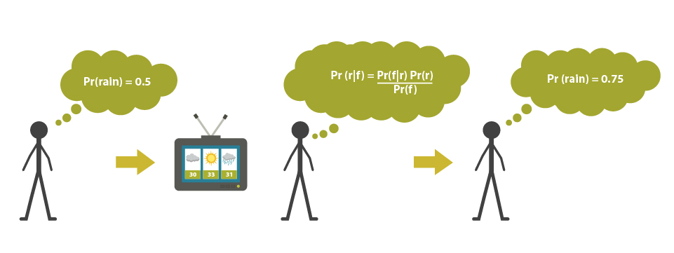

Slide 13
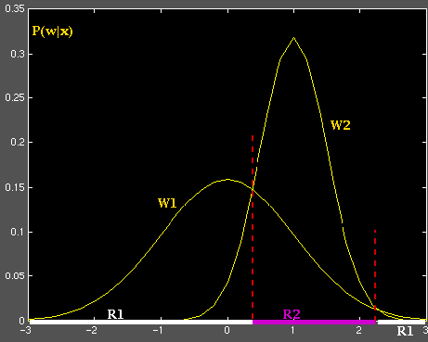
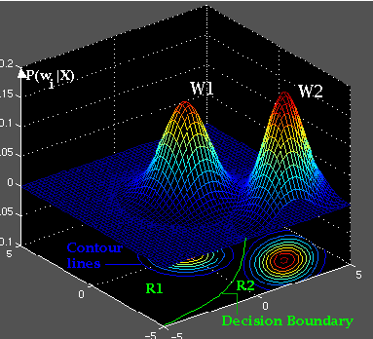
Decision region

Slide 14
Decision given the posterior probabilities: Bayes decision
X is an observation for which:
if P(ω₁ | x) > P(ω₂ | x) True state of nature = ω₁
if P(ω₁ | x) < P(ω₂ | x) True state of nature = ω₂
Therefore，
whenever we observe a particular x, the probability of error is :
P(error | x) = P(ω₁ | x) if we decide ω₂
P(error | x) = P(ω₂ | x) if we decide ω₁
P(error | x) = min(P(ω₁ | x) , P(ω₂ | x) )
Pattern Classification Chapter2(part 1)
Multi-class ?
13

Slide 15
Pattern Classification Chapter2(part 1)
14

Slide 16
Multi-class
if P(ω_{j} | x) > P(ω_{i} | x)
Then the true state of
nature = ω_{j}

Slide 17
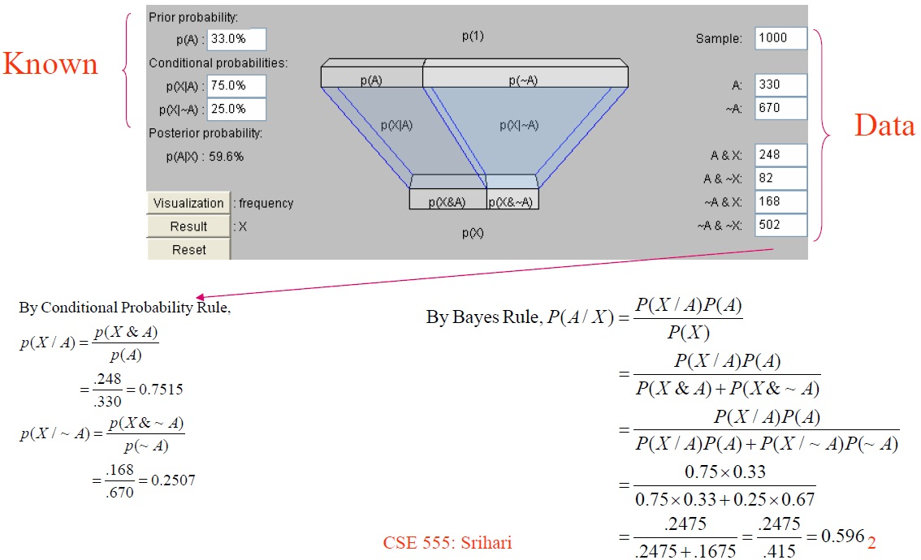
One example

Slide 18
Exercise
Problem:
A patient takes a lab test and the result is positive. The test returns a correct positive result in 98% of the cases in which the cancer disease is actually present, and a correct negative result in 97% of the cases in which the disease is not present. Furthermore, 0.8% of the entire population have this cancer disease. Does the patient suffers from the cancer?
Pattern Classification Chapter2(part 1)
17

Slide 19
Solution:
Given: P(+|cancer)=0.98
P(-|no cancer)=0.97
P(cancer)=0.008
P(-cancer)=0.992
Compute:
P(no cancer | +) , P(cancer | +),
Pattern Classification Chapter2(part 1)
18

Slide 20
P(-|no cancer)=0.97
P(+|no cancer)=1-0.97
P(+|cancer)=0.98
P(-|cancer)=1-0.98

Slide 21
Pattern Classification Chapter2(part 1)
20
P(cancer | +)=P(+|cancer)* P(cancer)/p(+)
P(cancer |+)=0.98X0.008/p (+)
P(cancer |+)= 0.00784 /p(+)

Slide 22
P(no cancer|+)=P(+|no cancer)*P(no cancer)/P(+)
P(no cancer|+)=(1-0.97)*(1-0.008)/ P(+)
P(no cancer|+)=0.02976 / P(+)
Since P(no cancer | +) > P(cancer | +), we decide that the patient does not have cancer
(Bayesian decision rule)
Pattern Classification Chapter2(part 1)
21

Slide 23
Exercise
Another Problem:
A person takes a lab test of nuclear radiation and the result is positive. The test returns a correct positive result in 99% of the cases in which the nuclear radiation is actually present, and a correct negative result in 95% of the cases in which the nuclear radiation is not present. Furthermore, 30% of the entire population are radioactively contaminated. Is this person contaminated ?
Pattern Classification Chapter2(part 1)
22

Slide 24
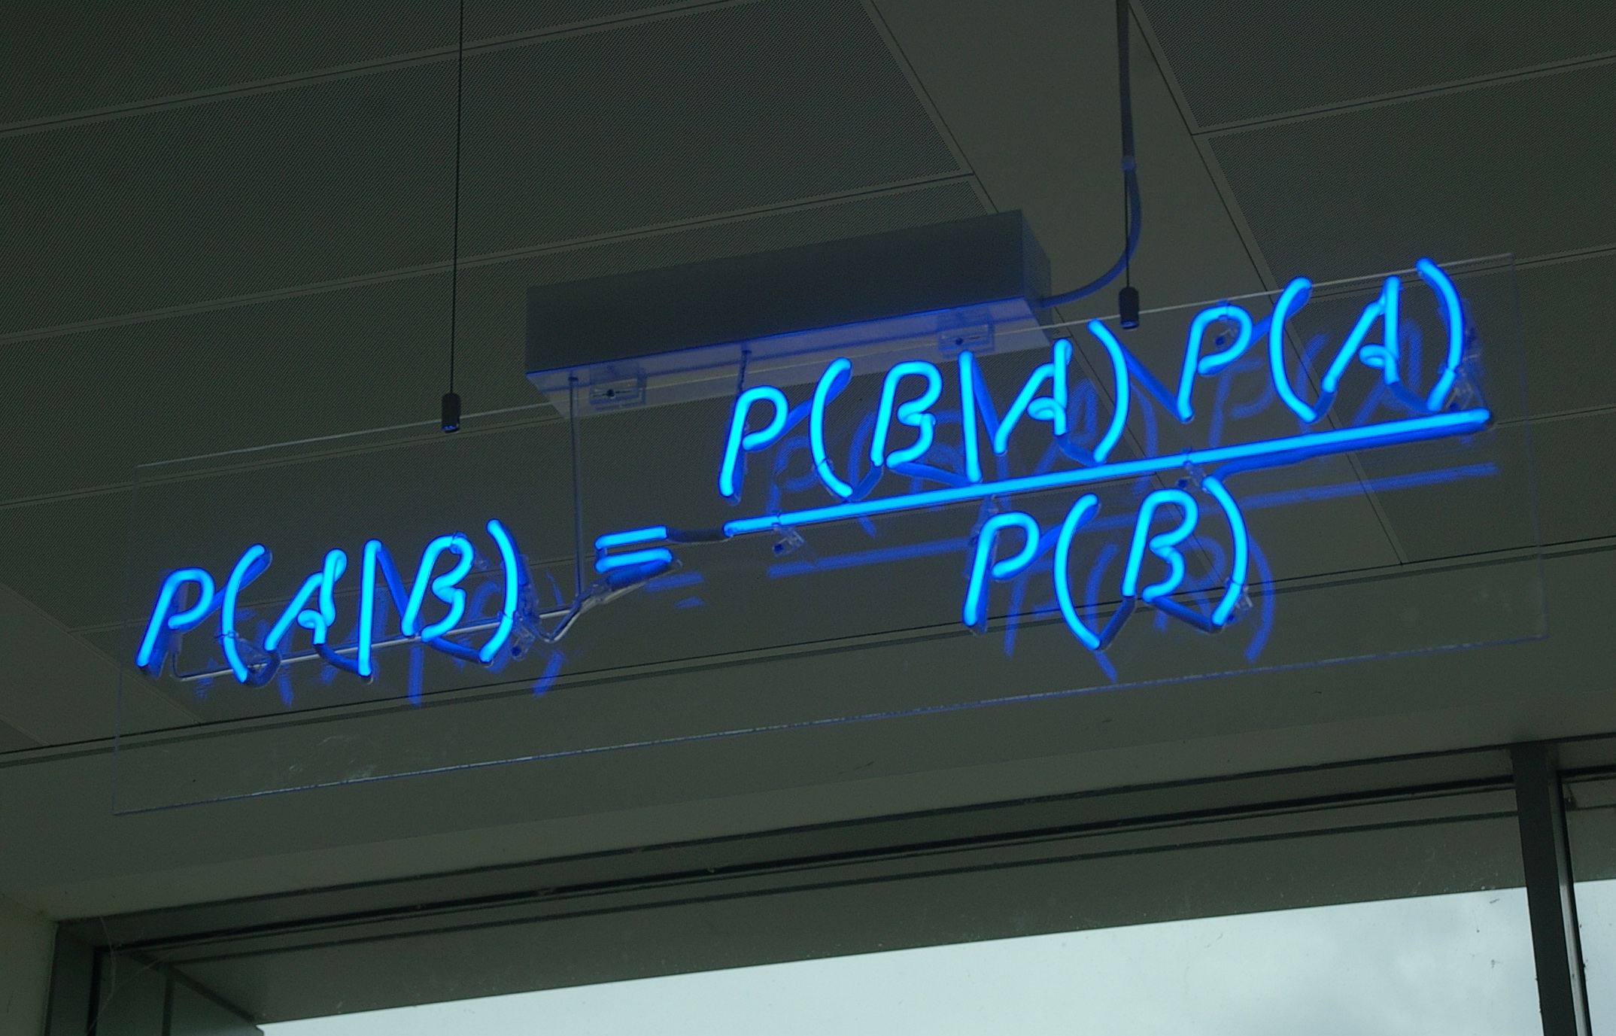

Slide 25
Bayesian Decision Theory – Continuous Features
Generalization of the preceding ideas
Use of more than one feature
Use more than two states of nature
Allowing actions and not only decide on the state of nature
Introduce a loss of function which is more general than the probability of error
Pattern Classification Chapter2(part 1)
24

Slide 26
Shortcoming of simple Bayesian decision
It have to let
X → ω_{i}
If the sample does not belong to any class, it
will still be assigned to a class
If I have no any confidence on
any decision, what should I DO?

Slide 27
Allowing actions other than classification primarily allows the possibility of rejection
Refusing to make a decision in close or bad cases!
The loss function states how costly each action taken is
Pattern Classification Chapter2(part 1)
26

Slide 28


Examples of classification with rejection
Consequence of no rejection: if a person (the user) is not one of the registered
users, he will be also erroneously recognized as a registered user!
Consequently this user will be erroneously allowed to pass the system!!

Slide 29

Personal identification & rejection
Reject

Slide 30
Let {ω₁, ω₂,…, ω_{c}} be the set of c states of nature
(or “categories”)
Let {α₁, α₂,…, α_{a}} be the set of possible actions
Let λ(α_{i} | ω_{j}) be the loss incurred for taking action α_{i} when the state of nature is ω_{j}
Pattern Classification Chapter2(part 1)
29

Slide 31
A simple case
ω₁, ω₂,…, ω_{c: C classes}
α₁, α₂,…, α_{c: C actions}
α_{c+1} : do not assign the sample into any class--- reject

Slide 32
Overall risk
R = Sum of all R(α_{i} | x) for i = 1,…,a
Minimizing R Minimizing R(α_{i} | x) for i = 1,…, a
for i = 1,…,a
Conditional risk
Pattern Classification Chapter2(part 1)
31

Slide 33
Select the action α_{i} for which R(α_{i} | x) is minimum
R is minimum and R in this case is called the Bayes risk = best reasonable result that can be achieved!
Pattern Classification Chapter2(part 1)
32

Slide 34
Two-category classification
α₁ : deciding ω₁
α₂ : deciding ω₂
λ_{ij} = λ(α_{i} | ω_{j})
λ_{ij} :loss incurred for deciding ω_{i} when the true state of nature is ω_{j}
Conditional risk: R(α₁ | x) = λ₁₁P(ω₁ | x) + λ₁₂P(ω₂ | x)
R(α₂ | x) = λ₂₁P(ω₁ | x) + λ₂₂P(ω₂ | x)
Pattern Classification Chapter2(part 1)
33

Slide 35
Our rule is the following:
if R(α₁ | x) < R(α₂ | x)
action α₁: “decide ω₁” is taken
This results in the equivalent rule :
decide ω₁ if:
(λ₂₁- λ₁₁) P(ω₁ |x) >(λ₁₂- λ₂₂) P(ω₂ |x)
and decide ω₂ otherwise
Pattern Classification Chapter2(part 1)
34

Slide 36
(λ₂₁- λ₁₁) P(ω₁ |x) >(λ₁₂- λ₂₂) P(ω₂ |x)
is equal to
(λ₂₁- λ₁₁) P(x|ω₁) P(ω₁) >(λ₁₂- λ₂₂) P(x|ω₂) P(ω₂)

Slide 37
Likelihood ratio:
The preceding rule is equivalent to the following
rule:
Then take action α₁ (decide ω₁). Otherwise take action α₂ (decide ω₂)
Pattern Classification Chapter2(part 1)
36

Slide 38
Optimal decision property
“If the likelihood ratio exceeds a threshold value independent of the input pattern x, we can take optimal actions”
Pattern Classification Chapter2(part 1)
37

Slide 39
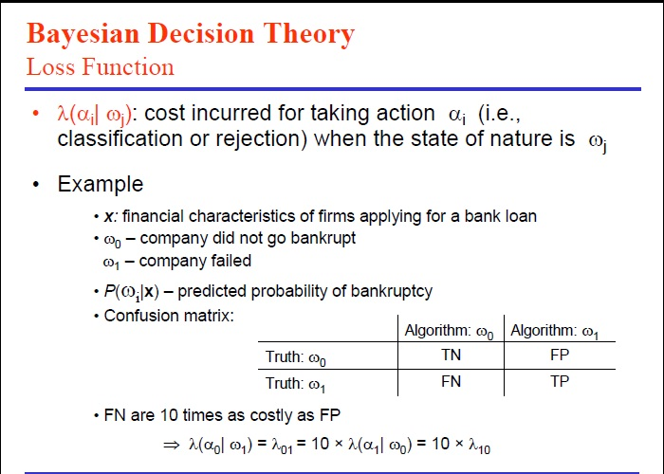

Slide 40
Simplest λ_{ij}
λ_{ij}=1, i<>j
λ_{ii}=0
Then minimum risk Bayesian decision will be equivalent to Minimum error Bayesian decision

Slide 41
Exercise
Select the optimal decision where:
= {ω₁, ω₂}
p(+ | ω₁) 0.9
p(+ | ω₂) 0.001
P(ω₁) = 0.01
P(ω₂) = 0.99
Pattern Classification Chapter2(part 1)
40

Slide 42
means λ₁₁=1, λ₁₂=4, λ₂₁=2, λ₂₂=3
Example: earthquake forecast; typhoon forecast

Slide 43
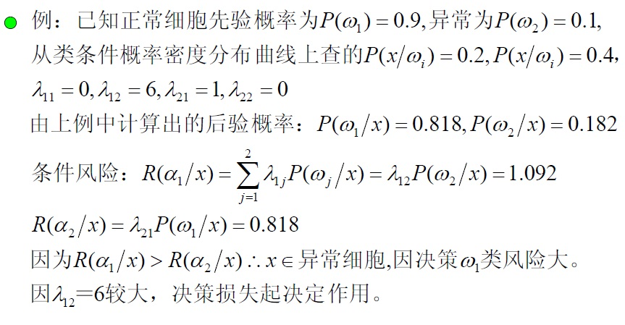
Example

